Slide 1
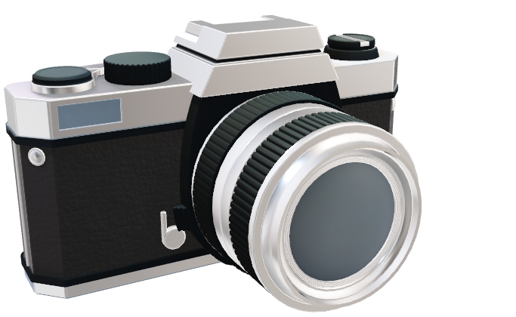
Engineering Design
Exercise 9
311511052 Po-Chuan Chen

Slide 2
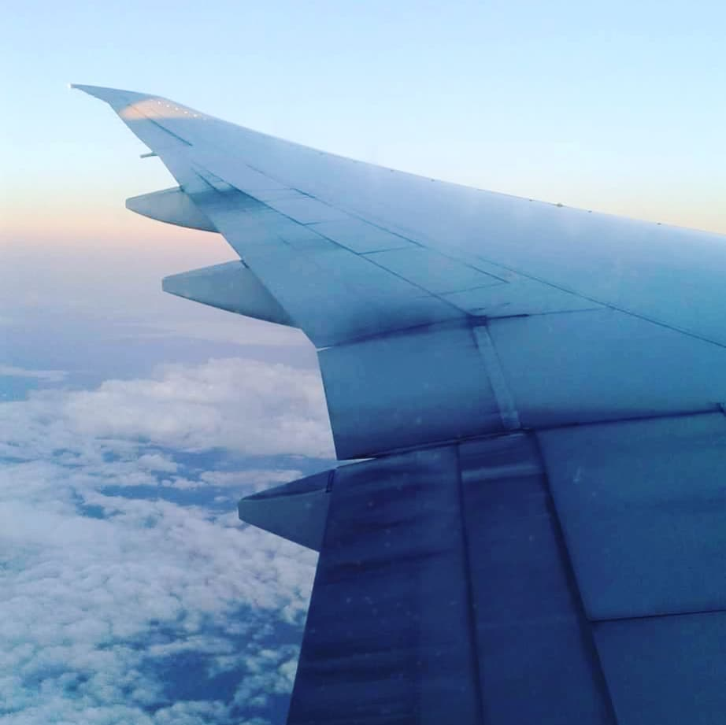
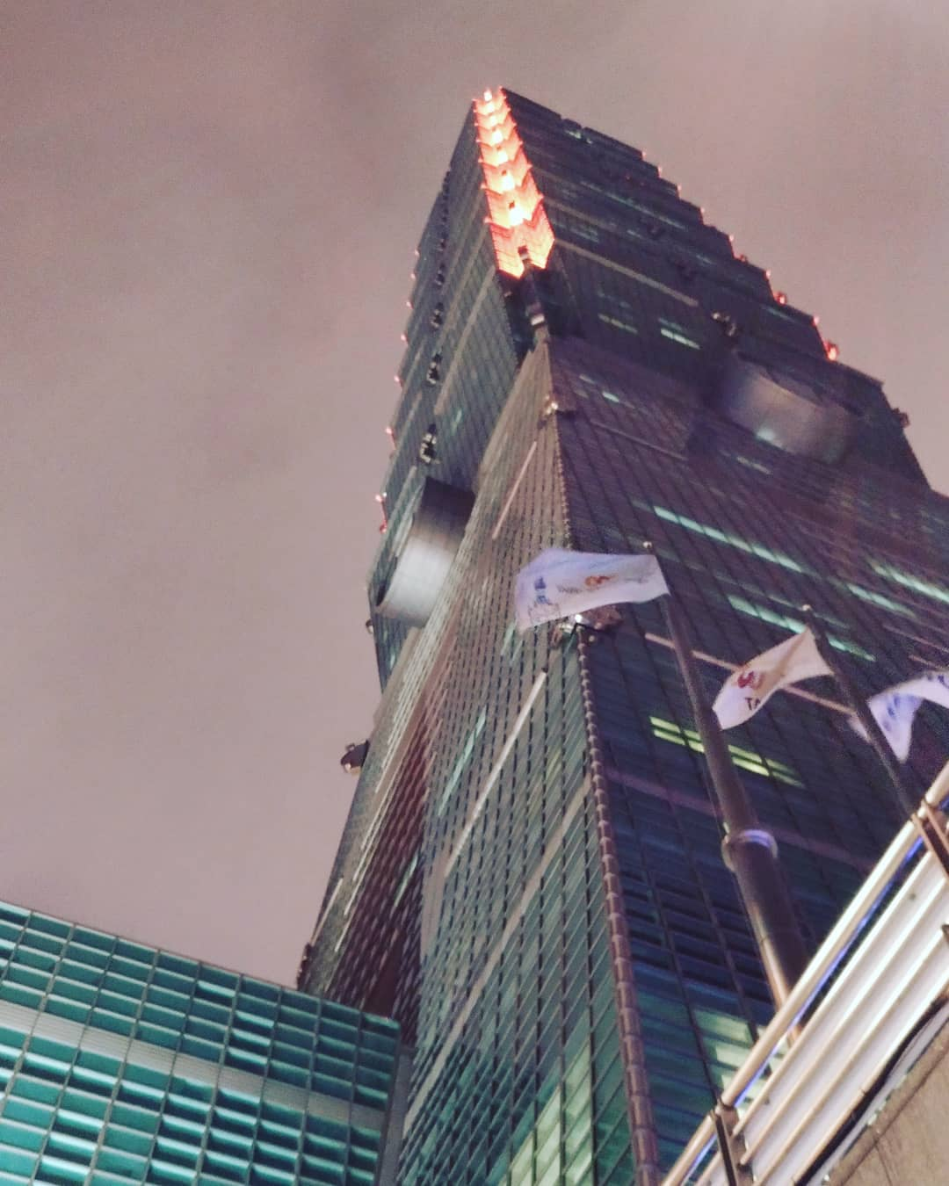
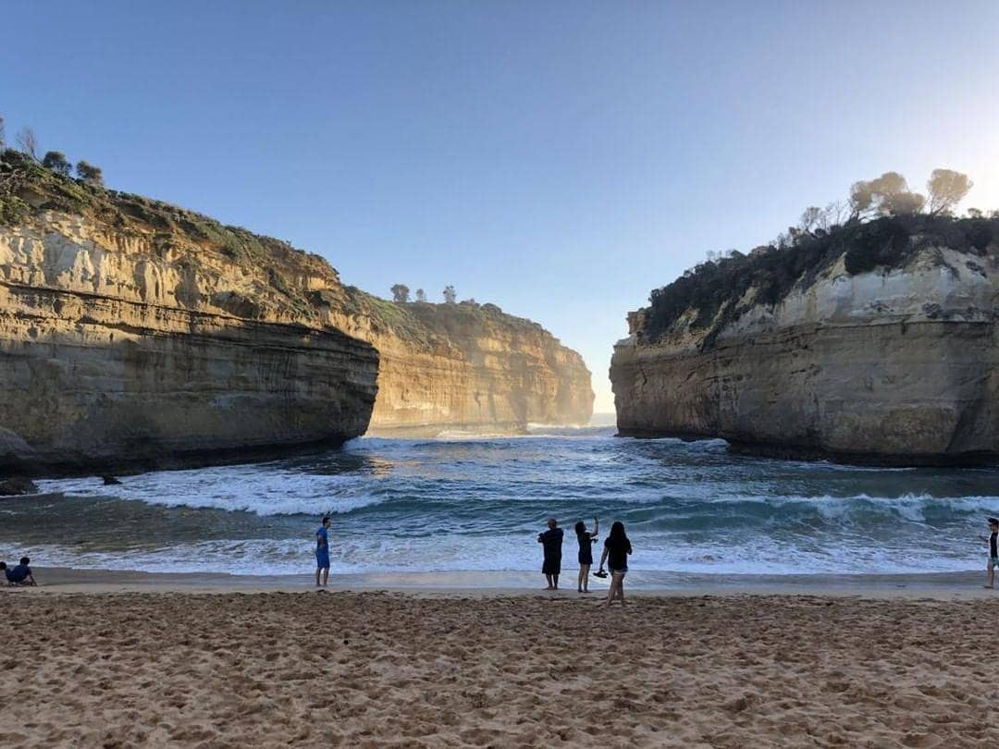
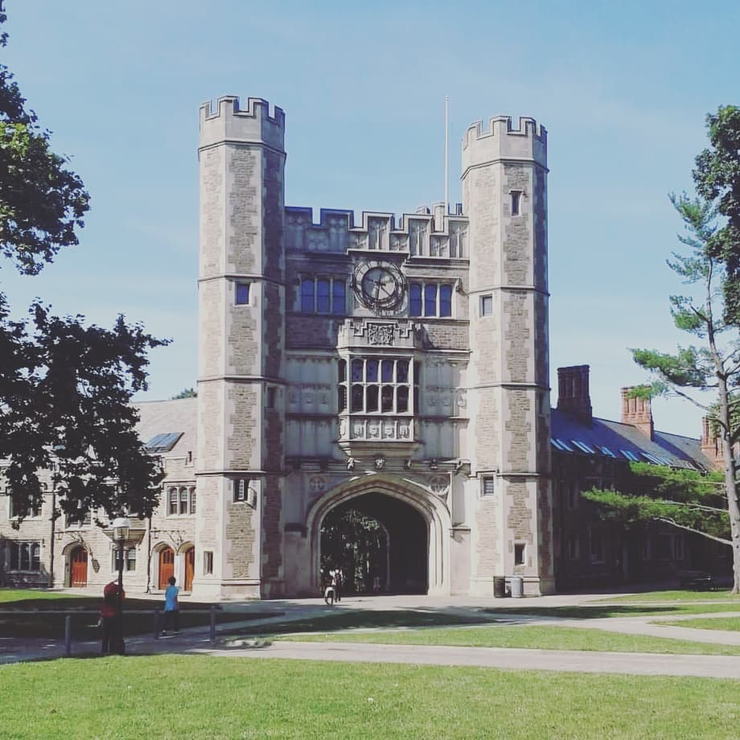
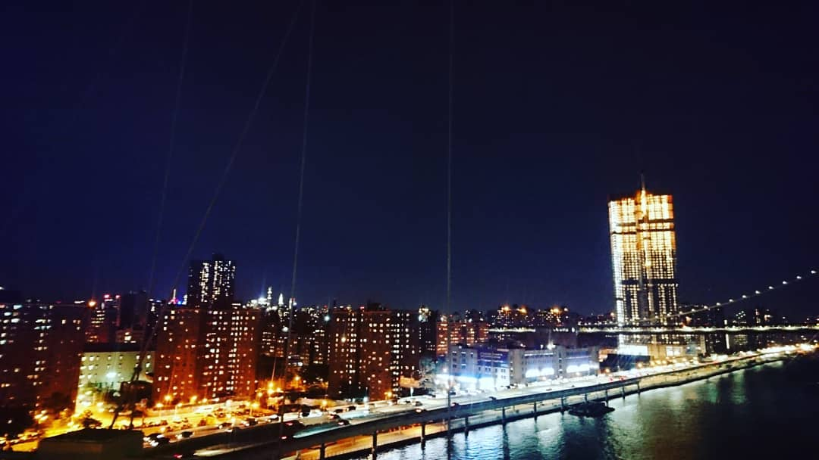

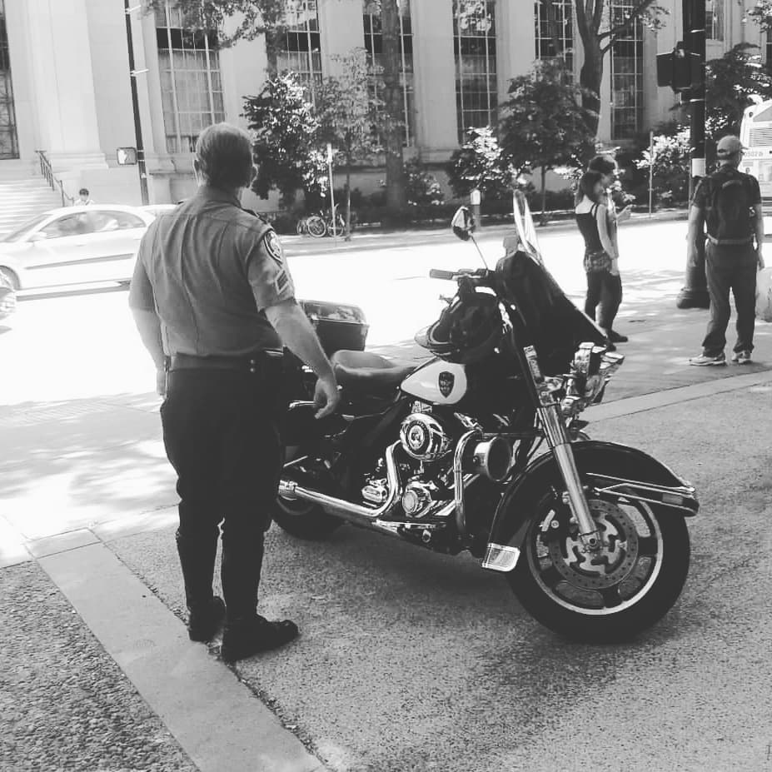
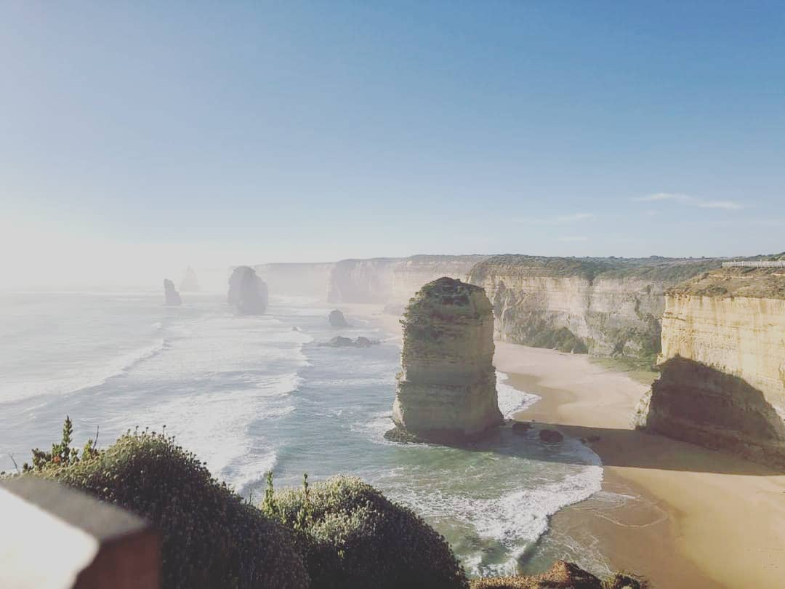
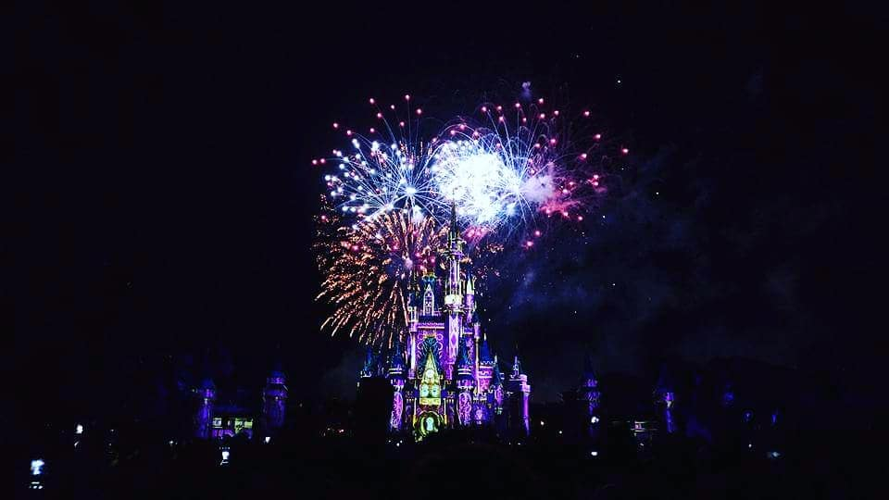
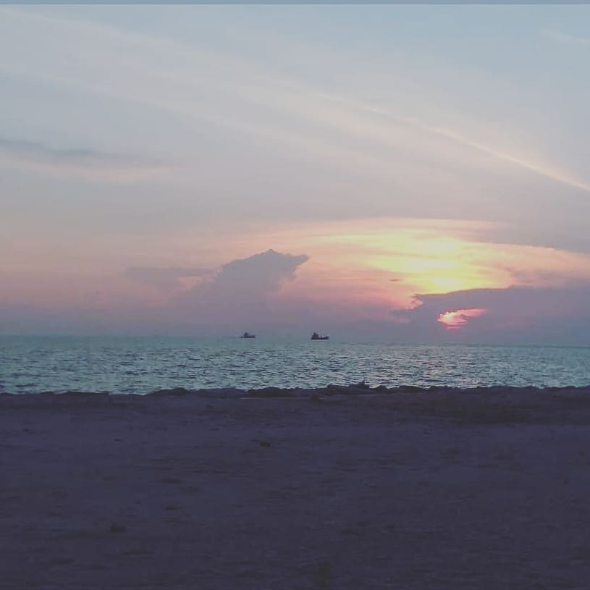
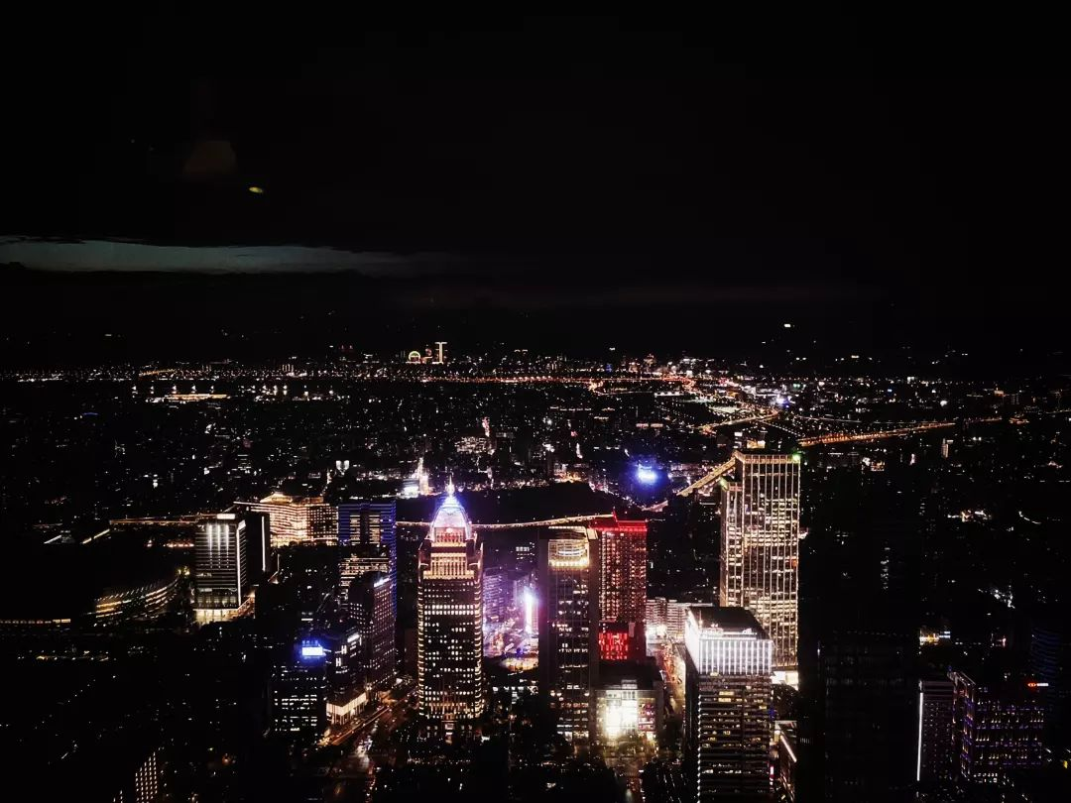
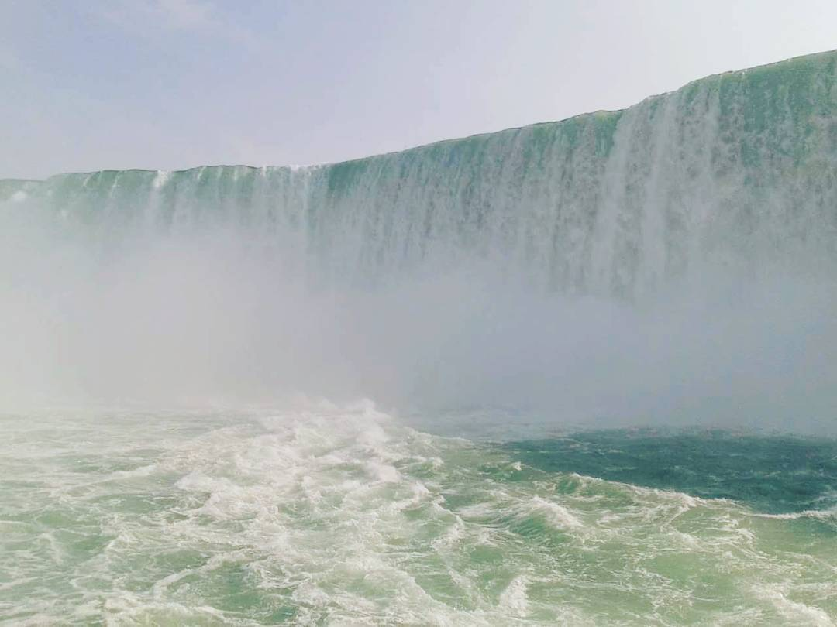
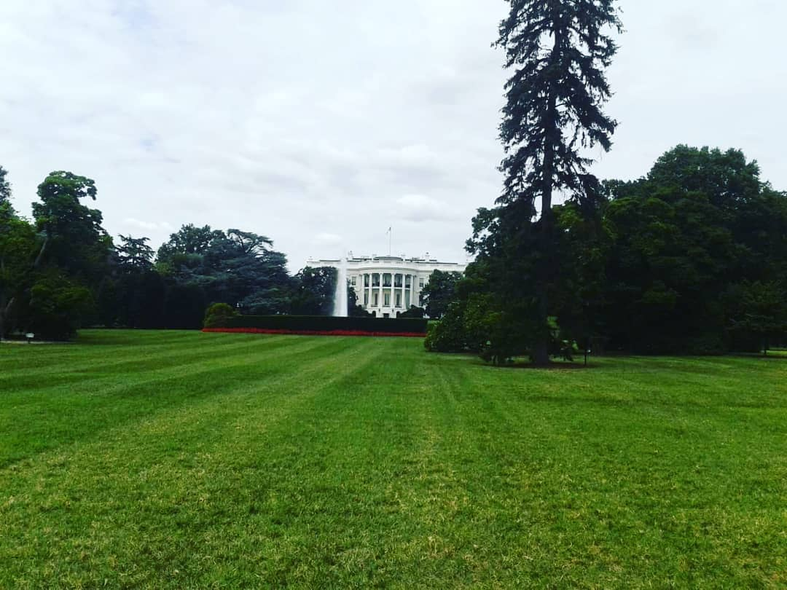
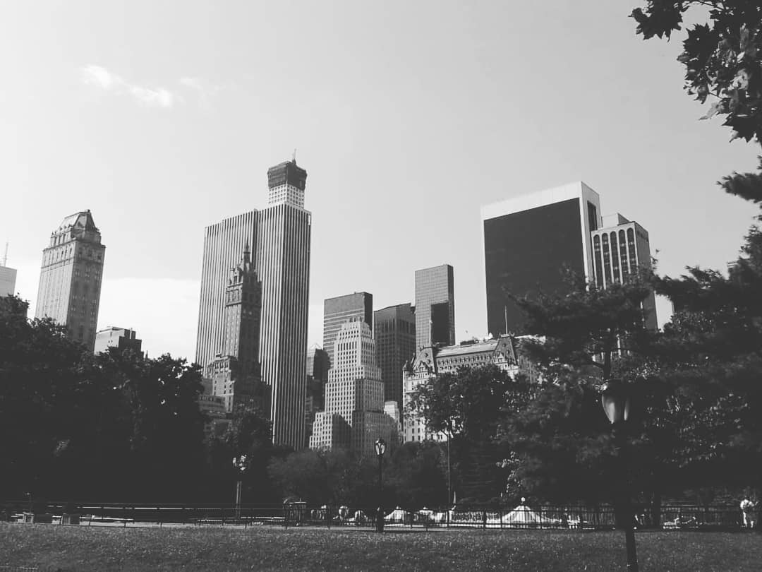
pho_1998

Slide 3
End (Jan 19, 2018) After something had ended . It's another start !!!
pho_1998

Slide 4
Taiwan (Jan 24, 2018) Great place to visit . It's amazing .
pho_1998

Slide 5
Summer time. (Aug 31, 2021)
pho_1998

Slide 6
Traveling (Jan 28, 2018) It's the best way to know the world .
pho_1998

Slide 7
City Life (Jan 21, 2018) New York City . Anything can happen in this city .
pho_1998

Slide 8
Malaysia Melaka. (Jul 1, 2020)
pho_1998

Slide 9
Childhood Memories (Jan 14, 2018) Fantastic memory from the Orlando Disneyland.
pho_1998

Slide 10
All those moments will be lost in time, like tears in rain. {Blade Runner} (Aug 29, 2020)
pho_1998

Slide 11
The ride (Jan 23, 2018) Going for a ride . And take some wonderful photos at the journey. It seems like a amazing plan.
pho_1998

Slide 12
Grandma (Jul 16, 2020)
pho_1998

Slide 13
pho_1998
Amazing night (Aug 11, 2023) The view from the Taipei 101 looks awesome!

Slide 14
pho_1998
Journey (Jan 31, 2018) It's great to experience anything in life .

Slide 15
pho_1998
Whitehouse (Feb 6, 2018) A historical place. For US. For World.

Slide 16
pho_1998
Things (Jan 27, 2018) It depends on how you look at the things happening on you.

Slide 17
pho_1998
Thanks & Cheers…

